Slide 1

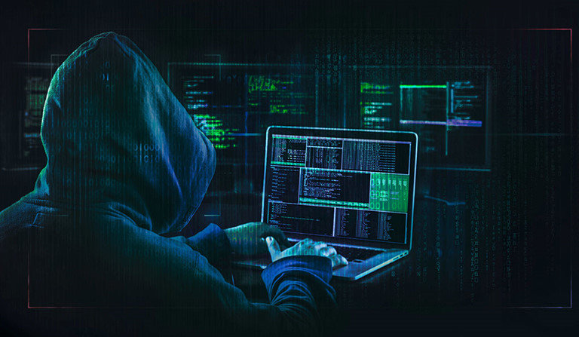
HACKERS AND VIRUSES
TRƯỜNG ĐẠI HỌC GIAO THÔNG VẬN TẢI THÀNH PHỐ HỒ CHÍ MINH
ENGLISH FOR INFORMATION TECHNOLOGY 2
TEACHER: BRYAN TẠ

Slide 2

GROUP 8
HOÀNG THỊ HÀ
NGUYỄN VĂN TRỌNG
PHẠM THỊ THÚY QUỲNH
PHAN TRỌNG TÍN
NGUYỄN ĐỨC THUẬN
TIẾU THỊ THANH NGÂN

Slide 3

REVIEW
VOCABULARY
LISTENING
READING
GRAMMAR
SUMMARY
SPEAKING

Slide 4


Slide 5

8
1
5
7
2
3
6
4
LUCKY STAR
NEXT

Slide 6


Star 1 : To _______things is to bring from multiple places and make them available in one location.
You are given 2 points
Centralize
Home

Slide 7
Star 2 :_______is the practice of labeling things with difference colors in order to tell them apart.
You are given 1 point
Color-coding
Home

Slide 8
Star 3 : To_______is to work at a location away from a main office by using technology.
You are given 2 points
telecommute
Home

Slide 9
Star 4 : _______is a program offered by the company 37 signals that organizes projects and can be accessed by multiple users simultaneously.
You are given 1 point
Basecamp
Home

Slide 10
Star 5 : A _______ is a display on a computer that shows commonly or recently used files and programs.
You are given 2 points
Dashboard
Home

Slide 11
Star 6 : A_______is a collection of icons or pictures that have been organized in a file or page.
You are given 2 points
Gallery
Home

Slide 12
Star 7 : To______ is to move from one file or setting to another.
You are given 0 point
Toggle
Home

Slide 13
Star 8 : If something is ______, it is available n the internet instead of on a disk.
You are given 0 point
Web-base
Home

Slide 14
Get ready! Before you read the passage, talk about these questions.
1. How do computer viruses impact business?
2. What should people do when their computers are infected?

Slide 15


Slide 16

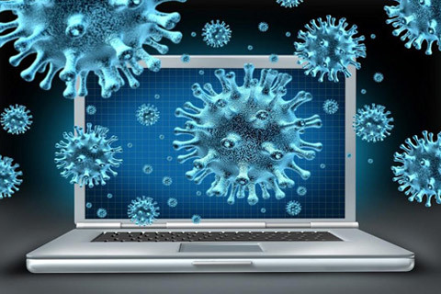
Virus / /ˈvaɪrəs/
A Virus is a harmful computer program file that takes up residence in a computer without the owner’s knowledge or permission
(Book 3, page 40)
Virut là một tệp chương trình máy tính có hại cư trú trong máy tính mà không có sự hiểu biết hoặc cho phép của chủ sở hữu.

Slide 17
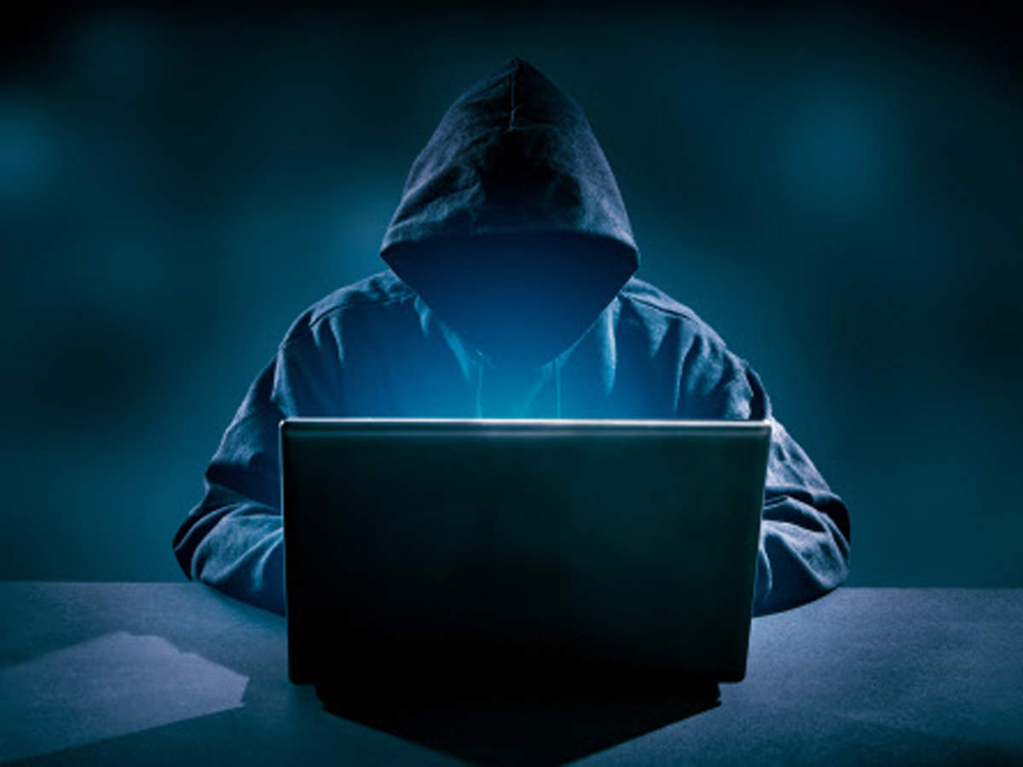
Tin tặc
Hacker /ˈhækər/
A hacker is a person who exploits computer hardware and software for their own purposes.
(Book 3, page 36)
Tin tặc là một người khai thác phần cứng và phần mềm máy tính cho mục đích riêng của họ.

Slide 18
Piggyback /ˈpɪɡiˌbæk//
Truy cập trái phép
To Piggyback is to gain unauthorized access to a computer system by taking advantage of the owners legitimate connection.
(Book 3, page 38)
Truy cập trái phép là giành quyền truy cập trái phép vào hệ thống máy tính bằng cách tận dụng kết nối hợp pháp của chủ sở hữu.

Slide 19
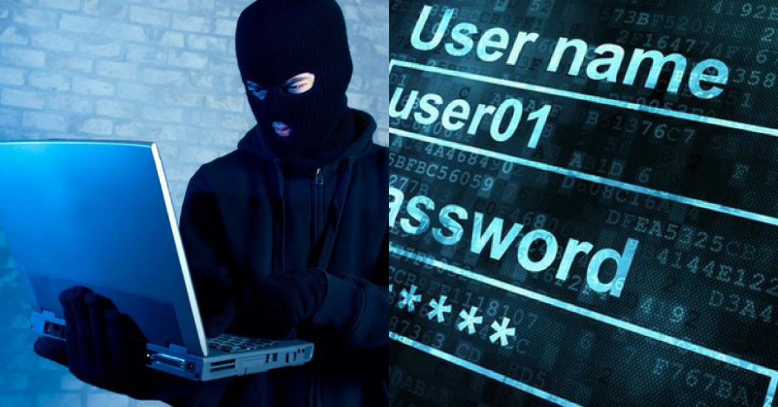
log in
Đăng nhập
To log in is to provide a computer security system with the proper identification to use the computer.
(Book 3, page 37)
Đăng nhập là cung cấp cho hệ thống bảo mật máy tính nhận dạng phù hợp để sử dụng máy tính.

Slide 20
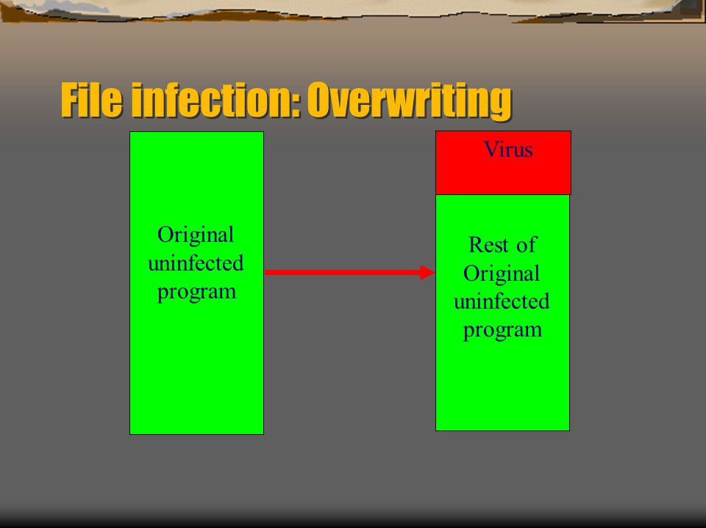
overwriting virus
/ˌoʊvərˈraɪtɪŋ/ /ˈvaɪrəs/
Virut ghi đè
An overwriting virus is a computer virus that copies its code over and destroys the files of the original data.
(Book 3, page 37)
Virut ghi đè là một vi-rút máy tính sao chép mã của nó và phá hủy các tệp của dữ liệu gốc.

Slide 21
anti-antivirus virus
/ˈ/ ænti -ˈæntiˌvaɪrəs/ /ˈvaɪrəs/
Virut chống phần mềm diệt virut
An anti-antivirus virus is a computer virus that attacks and often disables anti-virus software.
(Book 3, page 34)
Vi-rút chống vi-rút là vi-rút máy tính tấn công và thường vô hiệu hóa phần mềm chống vi-rút

Slide 22
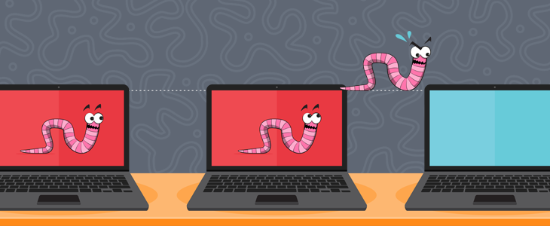
Lây nhiễm
Infect /ɪnˈfɛkt/
To Infect a computer is to contaminate it with a computer virus.
(Book 3, page 36)
Lây nhiễm máy tính là làm nó nhiễm vi-rút máy tính

Slide 23
Gắn vào
Imbed //ɪmˈbɛd/
To Imbed is to become a part of something.
(Book 3, page 36)
Gắn vào là trở thành một phần của một cái gì đó

Slide 24
Nhân bản
Replicate //ˈrɛpləˌkeɪt/
To replicate is to make copies of oneself.
(Book 3, page 38)
Nhân bản là tạo bản sao của chính mình.

Slide 25
virut trên trình duyệt dưới dạng tiện ích
resident extension
/ˈ /rɛzədənt/ /ɪkˈstɛnʃn/
A resident extension is an add-on to a computer virus that causes it to become a part of the host computer’s operating system.
(Book 3, page 37)
Virut trên trình duyệt dưới dạng tiện ích là một tiện ích bổ sung cho virus máy tính khiến nó trở thành một phần của hệ điều hành máy tính chủ máy tính.

Slide 26
resident virus
/rɛzədənt/ / ‘vaɪrəs /
Virut cư trú
A resident virus is a computer virus that becomes part of a file or disk drive but does nothing until activated by a trigger event.
(Book 3, page 38)
Virut cư trú
Virut cư trú là một vi-rút máy tính trở thành một phần của tệp hoặc ổ đĩa nhưng không làm gì cho đến khi được kích hoạt bởi một sự kiện kích hoạt.

Slide 27


Slide 28
LINCOLNSHIRE BANK
LOCAL MAN ARRESTED ON
Hacking Charges
(Wilmington) - Donald Greene has been arrested by Interpol on computer hacking charges. Interpol claims that Greene, a computer hacker, planted viruses on unwitting host computers. It is thought that Greene used a method called "piggybacking" to gain access to computers when their owners logged in. This gave him access to the computer's protective firewall and allowed him to disable it.
Interpol says that Greene has done over $50 million in damage. Most of this damage was done when he used overwriting viruses to overwrite and destroy files on government computer systems. But Greene targeted home computers, too. For these, anti-virus software was unable to stop Greene's viruses because he included anti-antivirus viruses with them. These viruses essentially shut down anti-virus software. Greene is also alleged to have used resident viruses. These viruses imbed themselves in a file or disk drive. When resident extensions are included with them, they become a part of the computer's operating system. This makes them nearly impossible to get rid of. As with all viruses, Greene's viruses are said to have replicated themselves quickly to infect multiple computers

Slide 29
1.What is the article mainly about?
A. New types of computer virus
B. A man who is investigating viruses
C. The capture of a man who used viruses
D. A way to protect compute
2. Which type of virus was the most harmful?
A. Overwriting viruses
B. Anti-antivirus viruses
C. Resident extensions
D. Resident viruses rs from viruses
3. What can be inferred about resident viruses?
A. They can disable firewalls.
B. They aid hackers with piggybacking.
C. They do less damage than anti-antivirus viruses.
D. They do not always include resident extensions.
Read the newspaper article.
Then, choose the right answers.

Slide 30
Match the words (1-7)with the definitions (A-G).
A a virus that attacks anti-virus software
B a program file that installs itself without permission
C an add-on that makes a computer virus part of the host computer's operating system
D a virus that copies its code over and destroys the files of the original data
E to gain unauthorized access to a computer system by using the owner's connection
F a computer system that has a virus attached to it
G a person who illegally exploits computer hardware and software
1 piggyback
2 hacker
3 host
4 overwriting virus
5 anti-antivirus virus
6 resident extension
7 virus

Slide 31
Write a word that is similar in meaning to the underlined part.
1 Email is used to contaminate computers with viruses.
infect
2 Enter identification that allows one to use a computer first.
log in
3 Some viruses can make copies of themselves.
replicate
4 If the virus becomes a part of something else, it will be hard to delete.
imbeds
5 Viruses that become part of files but do nothing until activated
can go unnoticed for months.
resident viruses

Slide 32
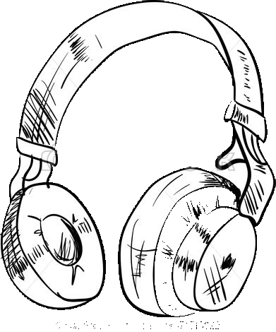
Listen and read the newspaper article again. How did Greene gain unauthorized access to other people's computers?
Greene used their connection when they logged in a method called “piggybacking”.

Slide 33

LISTENING

Slide 34
VI. Listen to a conversation between an employee and his manager. Mark the following statements as true(T) or false(F).
1.____ The manager read the newspaper article.
2.____ Overwriting viruses destroyed the manager’s files.
3.____ The manager decides to purchase new anti-virus software.
T
F
F

Slide 35
VII. Listen again and complete the conversation.
Employee: Have you seen this article in today’s paper? The one about the ______ ?
Manager: Yes, I have. What about it?
Employee: Well, I think the IT department needs to ___ ____ ____.
Manager: Do you think our company is vulnerable to these types of attacks?
Employee: Definitely. The overwriting viruses he used could do incredible damage.
Manager: I see. How much damage are we talking about?
Employee: Greene did millions of dollars’ worth of damage by _____ ___.
That could happen to us.
Manager: Something like that would
Employee: Exactly. I think these and resident extensions are a problem, too.
Manager: Why’s that?
Employee: Well, these types of viruses in files and disk drives.
hacker
make some changes
destroying files
ruin the company
resident viruses
Implant themselves
35

Slide 36

SPEAKING

Slide 37
VII. With a partner, act out the roles below based on Task 7. Then, switch roles.
A: Have you seen this article in today’s paper?
B: Oh, the one about the hacker? What about it?
A: Well, I think the IT department needs to make some changes.
B: Why? Do you think we’re vulnerable to virus attacks?
A: Sure! The overwriting viruses he used could do substantial damage.
B:How much damage are we talking about?
A: Millions of dollars worth! Greene did that just by destroying files.
B: Something like that would ruin the company.
A: Exactly. I think these resident viruses and resident extensions are a problem too.
B: Why’s that?
A: Well, these types of viruses implant themselves in files and dick drives.

Slide 38
GRAMMAR
Passive voice of that clause

Slide 39
S1 + V1 + that + S2 + V + ...
-> It is + V1 (pII) that + S2 + V + ...

Slide 40
Example:
1. They think that she works very hard.
-> It is thought that she works very hard.
2. They think that she worked very hard last year.
-> It is thought that she worked very hard last year.

Slide 41
S1 + V1 + that + S2 + V + ...
-> It was + V1 (pII) that + S2 + V + ...

Slide 42
Example:
1. People said that she was very kind.
-> It was said that she was very kind.
2. People said that she had been very kind.
-> It was said that she had been very kind.

Slide 43
Verb | P(II) | Mean
awake | awoken | thức, đánh thức
be | been | thì, là, bị, ở
become | become | trở nên
begin | begun | bắt đầu
bend | bent | bẻ cong
break | broken | đập vỡ
bring | brought | mang đến
buy | bought | mua
come | come | đến, đi đến
drive | driven | lái xe

Slide 44
1. People think that Maradona is the best football player in the 20th century.
-> It is thought that Maradona is the best football player in the 20th century.
2. That officer announced that the meeting was delayed until next week.
-> It was announced that the meeting was delayed until next week.
3. They promise that the performance will start on time.
-> It is promised that the performance will start on time.

Slide 45


Slide 46
1. How do computer viruses impact business?
As soon a computer is infected by a virus, it should be removed from any networks so that the virus doesn’t spread. Then, anti-virus software should be run to clean the computer. After the computer is reconnected, the user should update the anti-virus software and run it again. Users can implement a frequent backup schedule to make sure each day’s information is saved. This is recommended so that the most recent backup prior to the virus can be restored.

Slide 47
2. What should people do when their computers are infected?
Computer viruses infect millions of computers worldwide and very costly for firms with a large network system. They can have a great impact on business operations and as today’s viruses are developed from new technologies, they are becoming more difficult to track down. Viruses usually spread very quickly and in most cases, they will cause damage to host system. They can affect the screen and display appearance or decrease memory space, destroy program or steal information and data from the entire network which may be confidential. All of which have disastrous results for a business, it clients and employees.

Slide 48










END

Slide 49

A _____ is a harmful computer program file that takes up residence in a computer without the owner’s knowledge or permission
Virus
You are lost 1 point
GO HOME

Slide 50
To ______is to gain unauthorized access to a computer system by taking advantage of the owners legitimate connection.
Piggyback
You are given 2 points
GO HOME

Slide 51
A ________ is a person who exploits computer hardware and software for their own purposes.
Hacker
You are given 3 points
GO HOME

Slide 52
A _________is an add-on to a computer virus that causes it to become a part of the host computer’s operating system.
resident extension
You are given 1 point
GO HOME

Slide 53
An ________ is a computer virus that copies its code over and destroys the files of the original data.
overwriting virus
You are lost 1 point
GO HOME

Slide 54
An ________is a computer virus that attacks and often disables anti-virus software.
anti-antivirus virus
You are lost 2 points
GO HOME

Slide 55
To _________a computer is to contaminate it with a computer virus.
infect
You are given 2 points
GO HOME

Slide 56
A __________is an add-on to a computer virus that causes it to become a part of the host computer’s operating system.
resident extension
You are given 1 point
GO HOME

Slide 57



